Slide 1
INTRODUCTION TO DBMS & CONCEPTUAL DATABASE DESIGN
IE2042 | DMSS |Conceptual Database Design | Dr. Harinda Fernando

Slide 2

Learning Outcomes (LO1)
Understand what is a database management system
Determine the importance of using a DBMS
Understand the process of database designing
Ability to design a conceptual database for a given scenario
IE2042 | DMSS |Conceptual Database Design | Dr. Harinda Fernando

Slide 3
Topics
Overview of DBMS
Database Design process
Revision basic ER modeling
EER Concepts
Inheritance – IS-A Relationship
Aggregation
How to develop an EER
Exercises

Slide 4
What is a DBMS?
A database is a collection of related data
DBMS is a general purpose software system that facilitates the processes of defining, constructing, manipulating, and sharing databases among various users and applications
Simply, DBMS is a piece of software (package) that manages databases
Store data
Retrieve data
Information
SQL Command
DBMS
DB
IE2042 | DMSS |Conceptual Database Design | Dr. Harinda Fernando

Slide 5

Why a DBMS?
Large storage
Data independence
Efficient data access
Data integrity
Security
Easy data administration
Concurrent transaction processing
IE2042 | DMSS |Conceptual Database Design | Dr. Harinda Fernando

Slide 6
Database Design Process
1
Requirement Analysis
2
Conceptual Database Design
3
4
5
6
Logical Database Design
Schema Refinement
Physical Database Design
Security Design
IE2042 | DMSS |Conceptual Database Design | Dr. Harinda Fernando

Slide 7
Requirement Analysis
1
Purpose -> Gather and analyze the data requirements
How -> Interviews, Review documents/existing systems
Questions -> What to store?
Relationships among objects?
Types of queries?
Types of users?
Performance/ security/ administrative constraints?
Output -> Concisely written set of user requirements
IE2042 | DMSS |Conceptual Database Design | Dr. Harinda Fernando

Slide 8
Conceptual Database Design
2
High level conceptual model is designed encapsulating the user requirements
Entity Relationship (ER) Model is the widely used conceptual model
ER Model is enhanced with object oriented concepts (Inheritance and Aggregation) and known as the Enhanced Entity Relationship (EER) Model
IE2042 | DMSS |Conceptual Database Design | Dr. Harinda Fernando

Slide 9
Relational Model Terminology
A relation is a table with columns and rows.
Only applies to logical structure of the database, not the physical structure.
An attribute is a named column of a relation.
The degree of a relation is the number of attributes in a relation.
A domain is the set of allowable values for one or more attributes.
IE2042 | DMSS |Conceptual Database Design | Dr. Harinda Fernando

Slide 10
Relational Model Terminology
A tuple is a row of a relation.
The cardinality of a relation is the number of tuples in a relation.
A relational database is a collection of relations with distinct relation names.
The relations are usually normalized
Sometimes there are other kinds of objects in a relational database besides relations.
IE2042 | DMSS |Conceptual Database Design | Dr. Harinda Fernando

Slide 11
Relational Model Terminology
City
S#
Name
Status
London, Paris, etc..
Domains
Primary key
S#:S# | SNAME : NAME | STATUS : STATUS | CITY : CITY
S 1 | Smith | 20 | London
S 2 | Jones | 10 | Paris
S 3 | Black | 30 | Paris
S 4 | Clark | 20 | London
S 5 | Adams | 30 | Athens
Relation:
Cardinality
tuples
WORKER
Attributes
Figure 1
Degree

Slide 12
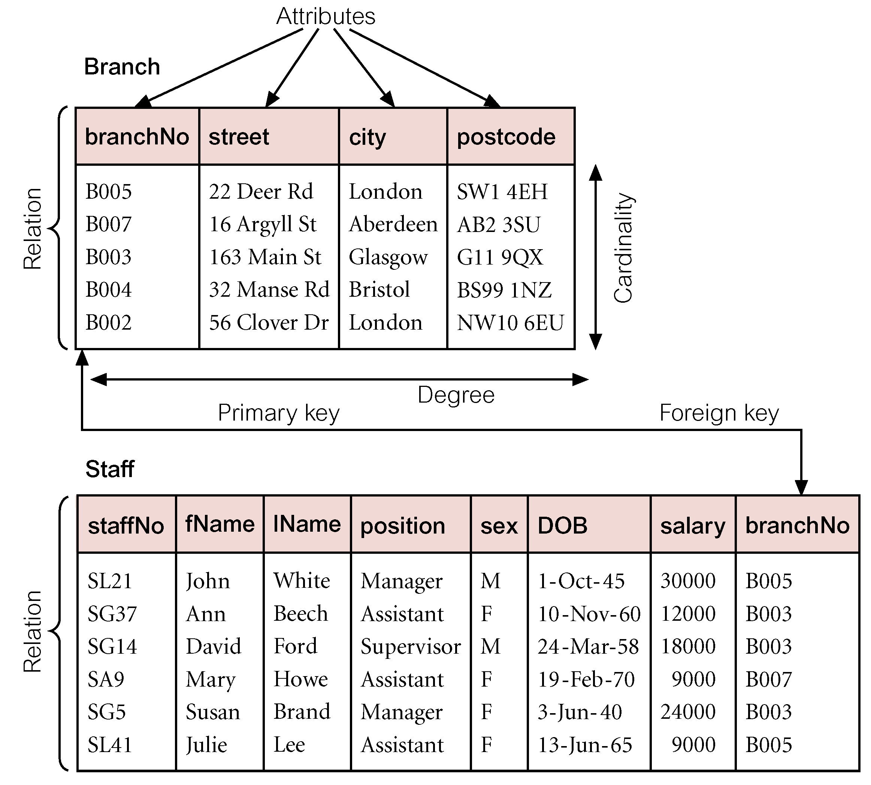
Relational Model Terminology
IE2042 | DMSS |Conceptual Database Design | Dr. Harinda Fernando

Slide 13
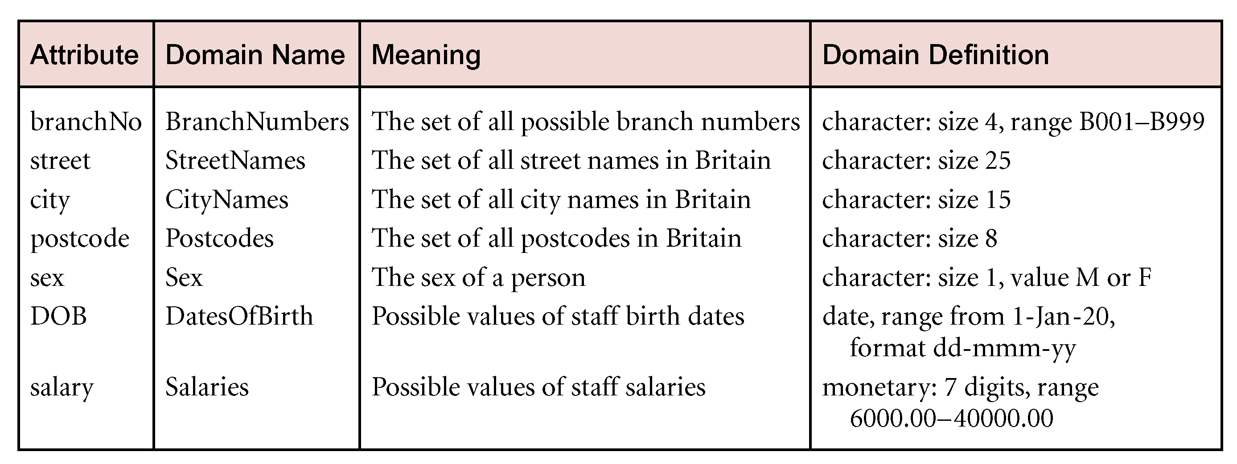
Relational Model Terminology
IE2042 | DMSS |Conceptual Database Design | Dr. Harinda Fernando

Slide 14
Concepts of a ER Model
Entity types
Relationship types
Attributes
IE2042 | DMSS |Conceptual Database Design | Dr. Harinda Fernando

Slide 15
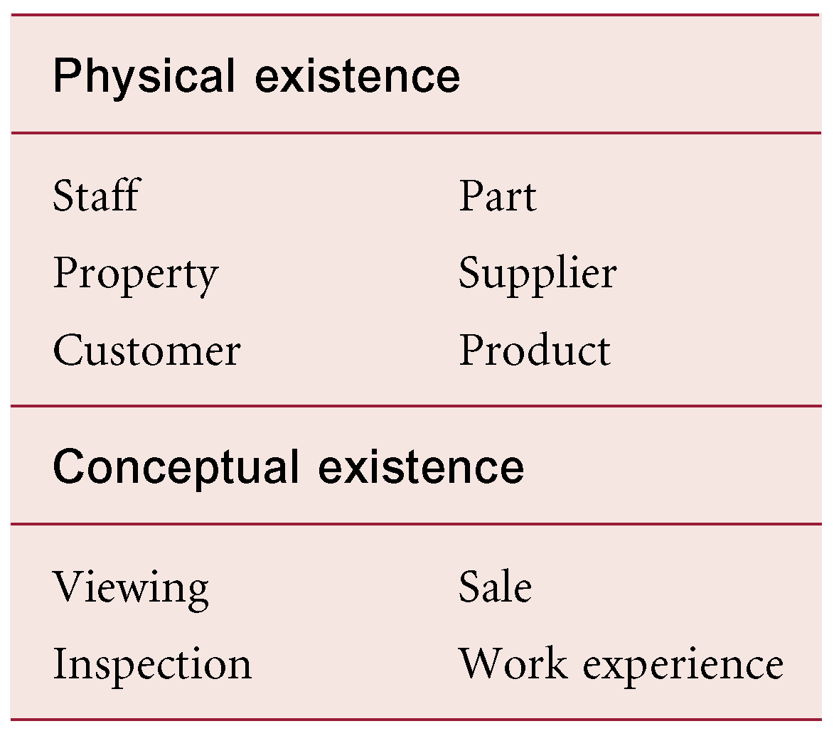
Entity Types
Entity type
Group of objects with the same properties, identified by the enterprise as having an independent existence.
E.g. The notebook computer entity type
Entity occurrence or entity instance
A uniquely identifiable object of an entity type.
E.g. The notebook computer on which I am now typing
IE2042 | DMSS |Conceptual Database Design | Dr. Harinda Fernando

Slide 16
Attributes and attribute domains
Attribute
Property of an entity or a relationship type.
Attribute Domain
Set of allowable values for one or more attributes.
IE2042 | DMSS |Conceptual Database Design | Dr. Harinda Fernando

Slide 17
Entities, Attributes & Keys
Simple Attribute
Multivalued Attribute
Composite Attribute
Derived Attribute
.
Name
Phone
Street
DOB
Address
Employee
City
EMP ID
NIC
AGE
IE2042 | DMSS |Conceptual Database Design | Dr. Harinda Fernando

Slide 18
Relationship Types
Relationship type
Set of meaningful associations among entity types.
Relationship occurrence
Uniquely identifiable association, which includes one occurrence from each participating entity type.
IE2042 | DMSS |Conceptual Database Design | Dr. Harinda Fernando

Slide 19
The Degree of a Relationship
Degree of a Relationship is the number of entities participating in the relationship.
A relationship between two entities is called a binary relationship
three is ternary
four is quaternary.
IE2042 | DMSS |Conceptual Database Design | Dr. Harinda Fernando

Slide 20
Binary Relationships
1:1
M:1
M:N
1
has
1
EMPLOYEE
PERSONAL FILE
EMPLOYEE
M
works
in
1
DEPARTMENT
M
works
for
N
EMPLOYEE
PROJECT
IE2042 | DMSS |Conceptual Database Design | Dr. Harinda Fernando

Slide 21
Relationships
works
for
EMPLOYEE
PROJECT
Assigned Date
oID
eID
place
EMPLOYEE
ORDER
ename
Value
cID
CUSTOMER
Name
IE2042 | DMSS |Conceptual Database Design | Dr. Harinda Fernando

Slide 22
Structural Constraints
Main type of constraint on relationships is called multiplicity.
Multiplicity - number (or range) of possible occurrences of an entity type that may relate to a single occurrence of an associated entity type through a particular relationship.
Represents policies (called business rules) established by user or company.
Binary relationships are generally referred to as being:
one-to-one (1:1)
one-to-many (1:*)
many-to-many (*:*)
IE2042 | DMSS |Conceptual Database Design | Dr. Harinda Fernando

Slide 23
Participation Constraints
works
for
EMPLOYEE
PROJECT
Total Participation - Mandatory
Partial Participation - Optional
An employee must work for a project
IE2042 | DMSS |Conceptual Database Design | Dr. Harinda Fernando

Slide 24
Weak Entities
pName
1
has
PROJECT
REPORT
date
pID
Name
---------
Total Participation
Partial Key
IE2042 | DMSS |Conceptual Database Design | Dr. Harinda Fernando

Slide 25
ISA Relationship
Specialization
Process of defining sub classes from an entity type
Generalization
Process of identifying commonalities between entity types and grouping them as super classes
Top Down Approach
Bottom Up Approach
IE2042 | DMSS |Conceptual Database Design | Dr. Harinda Fernando

Slide 26
ISA Relationship
eID
EMPLOYEE
name
Super Class
salary
ISA
Why create subclasses?
There may be attributes in the sub-class which are not in the superclass
There may be some relationship types that apply only to the sub-classes
TRAINEE
PERMANENT
period
bonus
Sub Classes
IE2042 | DMSS |Conceptual Database Design | Dr. Harinda Fernando

Slide 27
Disjointness Constraint
By default, two subclasses are considered DISJOINT(An entity cannot belong to more than one subclass)
Can an employee be a permanent employee and a contract employee? NO! Therefore, the permanent employee subclass and the contract employee subclass are disjoint.
Overlap Constraints determine whether two subclasses are allowed to contain the same entity
Can a person in a university be a student and a faculty member at the same time? YES! If it is so, we denote this by writing student overlaps faculty member. In absence of such a statement we assume that the sub classes are disjoint.
IE2042 | DMSS |Conceptual Database Design | Dr. Harinda Fernando

Slide 28
Disjointness Constraint
ename
name
eId
DOB
NIC
DOB
EMPLOYEE
PERSON
ISA
ISA
salary
contractId
salary
GPA
PERMANENT
CONTRACT
STUDENT
FACULTY MEMBER
hourly_
rate
hours_worked
Student overlaps Faculty Member
Permanent and Contract sub classes are disjoint
IE2042 | DMSS |Conceptual Database Design | Dr. Harinda Fernando

Slide 29
Completeness Constraint
Covering Constraints determine the entities in the subclass collectively include all the entities in the superclass
Does every employee belong to either permanent employee or a contract employee? YES! If it is so, we denote this by writing permanent employee and contract employee covers employee.
Does every person in a university belong to either student and a faculty member? NO! Therefore, there is no covering constraint.
Existence of a covering constraint is also known as having a Total Specialization
Absence of a covering constraint is known as having a Partial Specialization
IE2042 | DMSS |Conceptual Database Design | Dr. Harinda Fernando

Slide 30
Completeness Constraint
ename
name
eId
DOB
NIC
DOB
EMPLOYEE
PERSON
ISA
ISA
salary
contractId
salary
GPA
PERMANENT
CONTRACT
STUDENT
FACULTY MEMBER
hourly_
rate
hours_worked
Student and Faculty Member does not cover Person
Permanent Employee and Contract Employee Covers Employee
IE2042 | DMSS |Conceptual Database Design | Dr. Harinda Fernando

Slide 31
Options
 | Method | Overlapping | Disjoint | Total | Partial
Option 1 (Multi Relation) | Create additional separate tables for subclasses with same primary key | YES | YES | YES | YES
Option 2 (Multi Relation) | Create tables for just the subclasses | YES | YES | YES | NO
Option 3 (Single Relation) | Have table for superclass only with single type attributes | MAYBE | YES | YES | MAYBE
Option 4 (Single Relation) | Have table for superclass only with separate (Boolean) type attribute for each subclass | YES | YES | YES | YES

Slide 32
Aggregation
Sometimes it is possible for a relationship to participate in another
Difference between ternary and aggregation is that aggregation contains two independent relationships, whereas in ternary there is only one
IE2042 | DMSS |Conceptual Database Design | Dr. Harinda Fernando

Slide 33
Aggregation
Imaginary Entity
Plays
PLAYER
GAME
Player plays games. Based on the performance of the match, player wins an award.
Wins
titleno
AWARD
IE2042 | DMSS |Conceptual Database Design | Dr. Harinda Fernando

Slide 34
Process
Step 1 - First map relationship R as a new entity
Step 2 – To map the aggregate relationship treat the R entity as a normal entity and use the primary key of R in the mapping
Important – the cardinality of each relationship can be any of the possible options

Slide 35
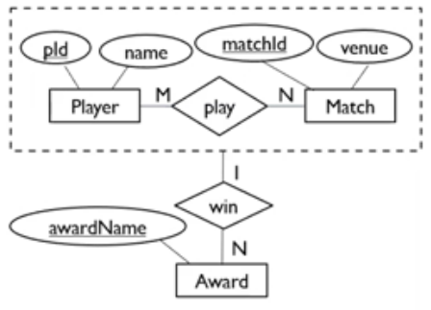
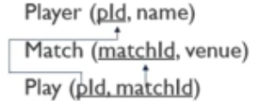
Example

Slide 36
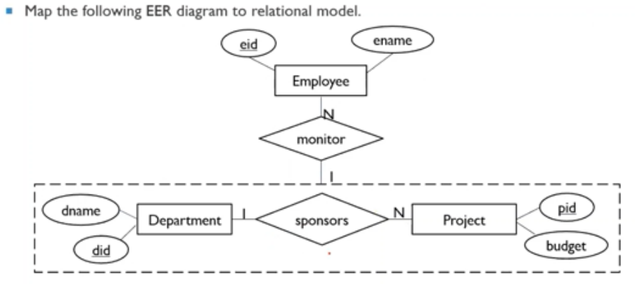
Exercise

Slide 37






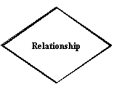

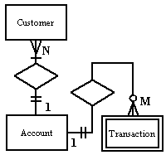

Chen Notation
Entity
Weak Entity
Attribute
Key attribute
Multivalued
attribute
Derived
attribute
Relationships
Weak
Relationships
Cardinality
Recursive
Relationship
IE2042 | DMSS |Conceptual Database Design | Dr. Harinda Fernando

Slide 38
How to build an ER Model
Identify data objects (entities) about which the system needs to store data.
For each entity, list its attributes and check the attributes for completeness.
Using the practical guidelines listed below, make any necessary improvements.
Data items should be put into logical groups – groups that go together.
For each data group, or entity, there should be a key that uniquely identifies individual members of that entity
IE2042 | DMSS |Conceptual Database Design | Dr. Harinda Fernando

Slide 39
How to build an ER Model
There should be no redundant data in the model – data is deemed redundant in the following situations:
The data is never used by the system
The same data items (customername, customeraddress) are stored in more than one place in the system.
Data in one place can be derived from data held in another place in the system.
IE2042 | DMSS |Conceptual Database Design | Dr. Harinda Fernando

Slide 40
How to build an ER Model
Investigate and record relationships.
link entities so that all significant real-life relationships are captured.
Check the entity descriptions against the data dictionary descriptions
Make sure that each process on the data flow diagram has available to it all the data it needs;
[i] Britton, C., Doake, J., Chapter 5: Data Modelling, Software System Development – A gentle introduction, McGraw-Hill
IE2042 | DMSS |Conceptual Database Design | Dr. Harinda Fernando

Slide 41
Activity
Draw an EER diagram for the following requirements.
Students contain an id (unique), name and an address.
There are academic semesters containing a semester id (unique), semester and year.
There are courses offered during academic semesters. A course has a number (unique), name and credits.
Students make payments. A payment has receipt number (unique), amount and date.
Payments can be classified into Tuition (semester payment), Examination and Other (Library fine, Printouts).
A Tuition payment is made for an academic semester.
For other payments description should be stored.
Students register for courses offered during a particular semester. The registered date must be stored in the database.
IE2042 | DMSS |Conceptual Database Design | Dr. Harinda Fernando

Slide 42

The End…
Complete the tutorial
Complete the lab sheet
IE2042 | DMSS |Conceptual Database Design | Dr. Harinda Fernando

